Slide 1
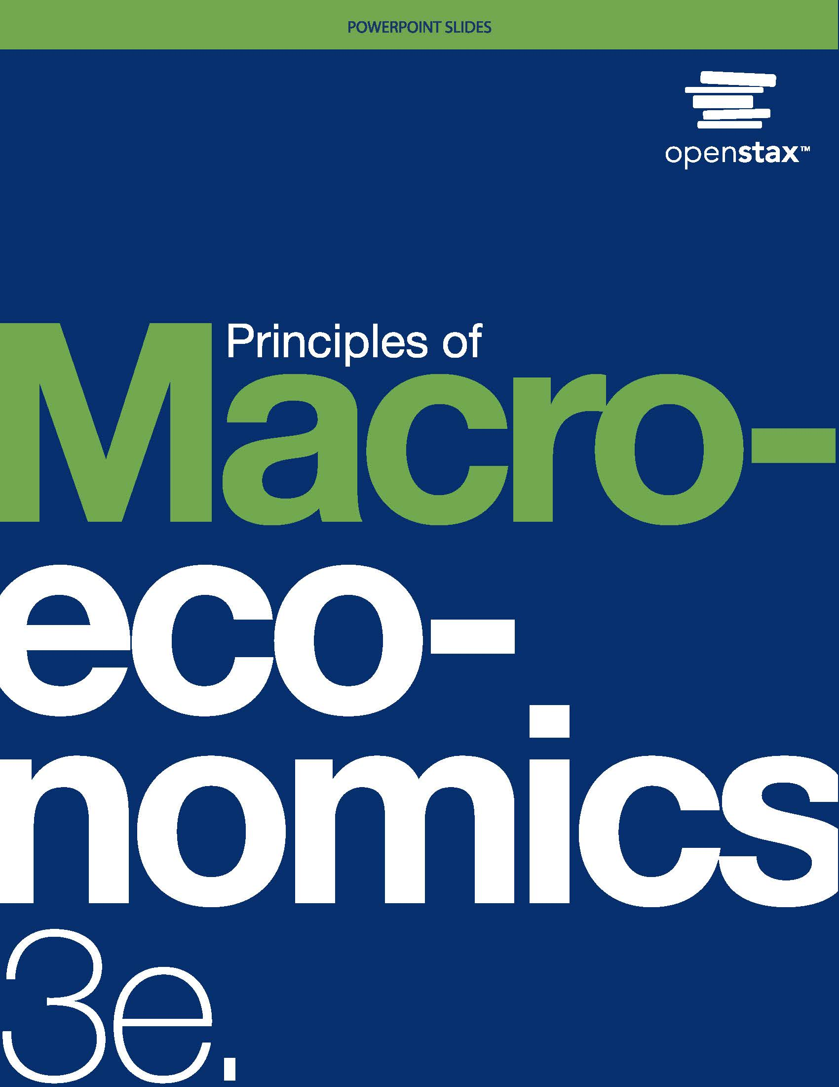
Principles of Macroeconomics 3e
Chapter 14 MONEY AND BANKING
PowerPoint Image Slideshow

Slide 2
Ch.14 OUTLINE
14.1: Defining Money by Its Functions
14.2: Measuring Money: Currency, M1, and M2
14.3: The Role of Banks
14.4: How Banks Create Money

Slide 3
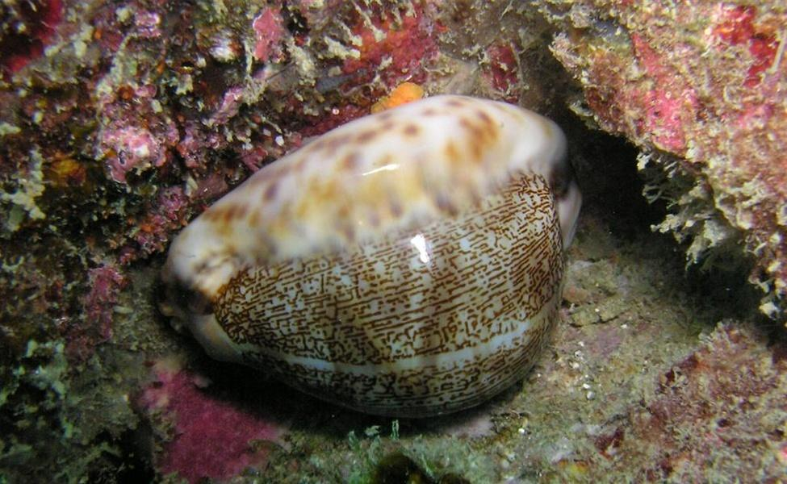
Cowrie Shell or Money?
Is this an image of a cowrie shell or money?
The answer is: Both.
For centuries, people used the extremely durable cowrie shell as a medium of exchange in various parts of the world.
(Credit: modification of “Cowry Shell (Cypraeidae)” by Silke Baron/Flickr Creative Commons, CC BY 2.0)

Slide 4
14.1 Defining Money by Its Functions
What the world would be like without money?
Barter - trading one good or service for another, without using money.
Double coincidence of wants - a situation in which two people each want some good or service that the other person can provide.

Slide 5
Functions for Money
Money - whatever serves society in four functions:
Medium of exchange - whatever is widely accepted as a method of payment.
Store of value - something that serves as a way of preserving economic value that one can spend or consume in the future.
Unit of account - the common way in which we measure market values in an economy.
Standard of deferred payment - money must also be acceptable to make purchases today that will be paid in the future.

Slide 6
Commodity versus Fiat Money
Commodity money - an item that is used as money, but which also has value from its use as something other than money.
Commodity-backed currencies - dollar bills or other currencies with values backed up by gold or another commodity.
During much of its history, gold and silver backed the money supply in the United States.

Slide 7
Commodity versus Fiat Money, Continued
Now, by government decree, if you owe a debt, then legally speaking, you can pay that debt with the U.S. currency, even though it is not backed by a commodity.
President Nixon took us off the gold standard in 1971. (Why?)
Fiat money - has no intrinsic value, but is declared by a government to be the country's legal tender.
The only backing of our money is universal faith and trust that the currency has value, and nothing more.

Slide 8
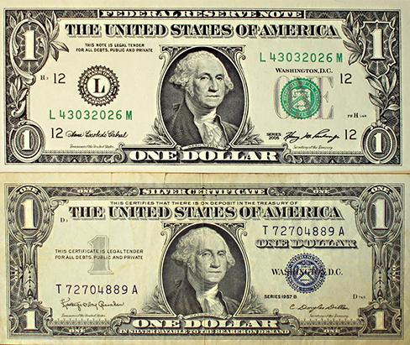
A Silver Certificate and a Modern U.S. Bill
Until 1958, silver certificates were commodity-backed money - backed by silver, as indicated by the words “Silver Certificate” printed on the bill, pictured at bottom.
Today, The Federal Reserve backs U.S. bills, but as fiat money (inconvertible paper money made legal tender by a government decree). (Credit: "One Dollar Bills" by “The.Comedian”/Flickr Creative Commons, CC BY 2.0)

Slide 9
14.2 Measuring Money: Currency, M1, and M2
The Federal Reserve Bank:
The central bank of the United States,
Bank regulator and responsible for monetary policy,
Defines money according to its liquidity.

Slide 10
Components of the Money Supply:
M1 (narrow) money supply includes:
Coins and currency in circulation
Checkable (demand) deposits
M2 (broad) money supply includes:
All M1 types
Savings deposits
Money market fund
Certificates of Deposit (CD’s)

Slide 11
Where Does “Plastic Money” Fit In?
Debit card & Smart card - are different ways to move money
Credit card purchases are a short-term loans. (Not money!)
Most "money" is in the form of bank accounts, which exist only as electronic records on computers.
Only about $2 trillion worth of currency in circulation.

Slide 12
Banks as Financial Intermediaries
Financial intermediary - an institution that operates between a saver with financial assets to invest and an entity who will borrow those assets and pay a rate of return.
Discussion Question: What are institutions in the financial market, other than banks, that are financial intermediaries?
Insurance companies
Pension funds
Depository institution - institution that accepts money deposits and then uses these to make loans.

Slide 13
A Bank’s Balance Sheet
Balance sheet - an accounting tool that lists:
Asset - item of value that a firm or an individual owns.
Liability - any amount or debt that a firm or an individual owes.
Net worth - the excess of the asset value over and above the amount of the liability; total assets minus total liabilities. (aka Bank capital)

Slide 14
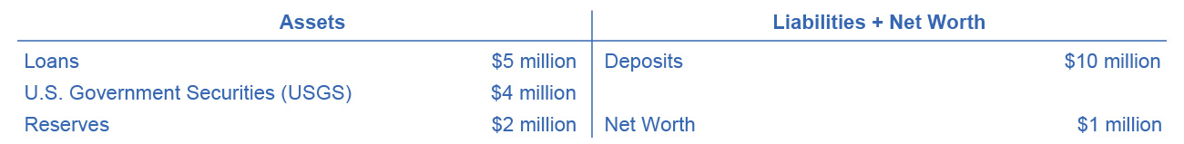
A Bank’s Balance Sheet
This figure shows a hypothetical and simplified balance sheet for the Safe and Secure Bank.

Slide 15
Reserves and Bankruptcy
Reserves - funds that a bank keeps on hand and that it does not loan out or invest in bonds. (The FED requires that banks keep a certain percentage of depositors’ money on “reserve”.)
We define net worth of a bank as its total assets minus its total liabilities.
For a financially healthy bank, the net worth will be positive.
If a bank has negative net worth and depositors tried to withdraw their money, the bank would not be able to give all depositors their money.

Slide 16
How Banks Go Bankrupt
Potential problems for a bank:
High rate of loan defaults
Asset-liability time mismatch - the ability for customers to withdraw bank’s liabilities in the short term while customers repay its assets in the long term.
Strategies to reduce risk:
Diversify - making loans or investments with a variety of firms, to reduce the risk of being adversely affected by events at one or a few firms.
Sell some of the loans they make in the secondary loan market.
Hold a greater share of assets (government bonds or reserves).

Slide 17
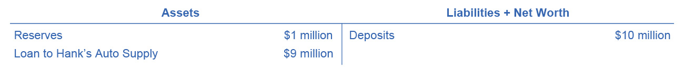
14.4 How Banks Create Money, Part 1
The banking system can create money through the process of making loans.
Singleton Bank Balance Sheet
In the T-account balance sheet above, Singleton Bank is simply storing money for depositors, and not making loans.
It cannot earn any interest income and cannot pay its depositors an interest rate.
Singleton Bank Balance Sheet
Now, by loaning out $9 million and charging interest, it will be able to make interest payments to depositors.
This alters Singleton Bank’s balance sheet:
It now has $1 million in (required 10%) reserves and a loan to Hank’s Auto Supply of $9 million.

Slide 18
How Banks Create Money, Part 2
First National Balance Sheet
Singleton Bank issues Hank’s Auto Supply a cashier’s check for the $9 million.
Hank deposits the loan in his regular checking account with First National Bank.
The deposits at First National Bank rise by $9 million and its reserves also rise by $9 million.
Bank lending has expanded the money supply by $9 million.
First National Balance Sheet
Now, First National Bank must hold some required reserves ($900,000) but can lend out the other amount ($8.1 million) in a loan to Jack’s Chevy Dealership.

Slide 19
How Banks Create Money, Part 3
Second National Balance Sheet
If Jack’s Chevy Dealership deposits the loan in its checking account at Second National, the money supply just increased by an additional $8.1 million.
Making loans that are then deposited into a demand deposit account increases the M1 money supply.
This money creation is possible because there are multiple banks in the financial system.
They are required to hold only a fraction of their deposits,
loans end up deposited in other banks,
which increases deposits and the money supply.

Slide 20
Cautions about the Money Multiplier
The quantity of money in an economy is closely linked to the quantity of lending or credit in the economy.
All the money in the economy, except for the original reserves, is a result of bank loans that institutions repeatedly re-deposit and loan.
A bank can also choose to hold extra reserves, above the required amount.
Banks may decide to vary how much they hold in reserves for two reasons:
macroeconomic conditions
government rules

Slide 21
Cautions about the Money Multiplier, Continued
In a recession, banks are likely to hold a higher proportion of reserves due to fear that customers are less likely to repay loans.
The Federal Reserve may also raise or lower the required reserves held by banks as a policy move to affect the quantity of money in an economy.
Additionally, if people do not deposit cash, banks cannot recirculate the money in the form of loans.

